Slide 1
Convolutional Neural Network For STICTION Detection
Notes:
This provide the brief of deep learning application specially CNN for Industrial domain
The presence of nonlinearities in a control valve, limits the control loop performance.
Stiction is the most commonly found problem in the pneumatic control valves.

Slide 2
Summary
Closed loop control and Stiction
Different types of networks (considered in this work)
Stiction Detection Project

Slide 3
Closed loop control and stiction

Slide 4
Closed loop control
Disturbance
SP
+
Controller
Gc
OP
Process
Gp
-
PV
Transmitter
Gh
PID controller is the controller used in almost all the modern DCS.
It is a linear controller
If Process is non linear the loop may exhibit oscillations.

Slide 5
Closed loop control
Disturbance
SP
+
Controller
Gc
OP
Valve
Gv
Process
Gp’
-
PV
Transmitter
Gh
Positioner
Valve Characteristics
Valve Limits
Stiction

Slide 6
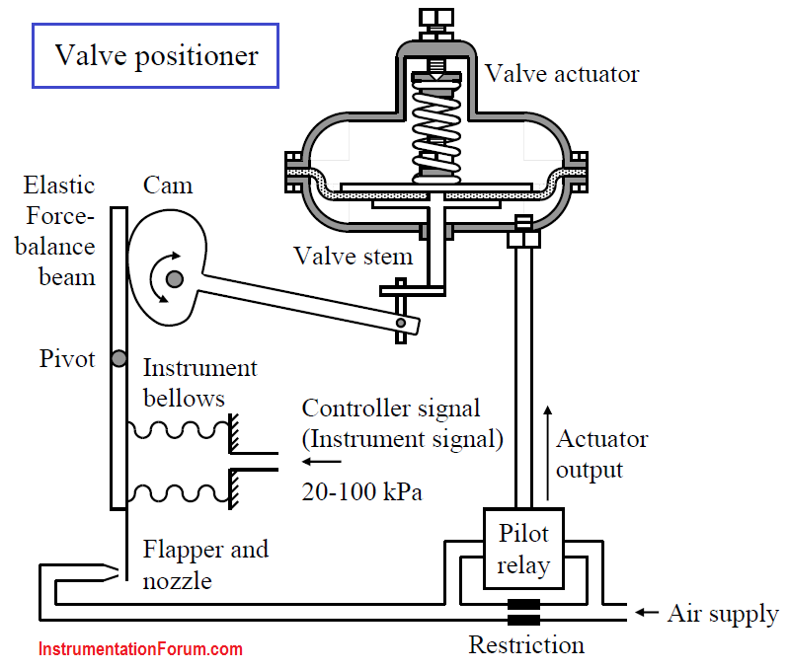
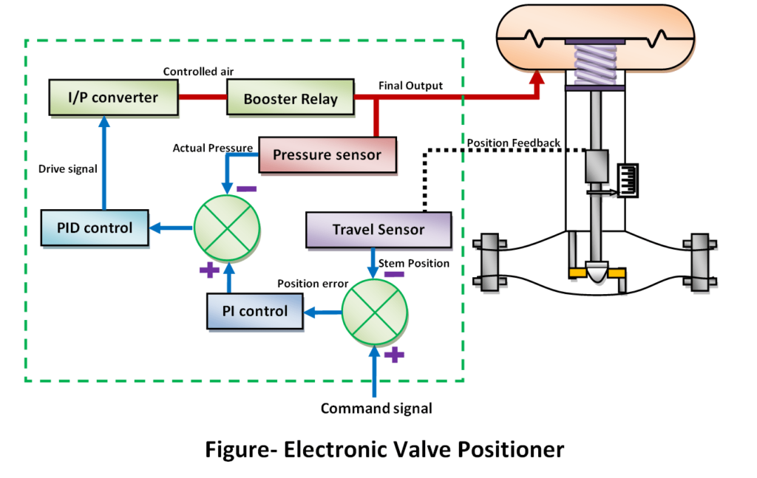
Valve positioners

Slide 7
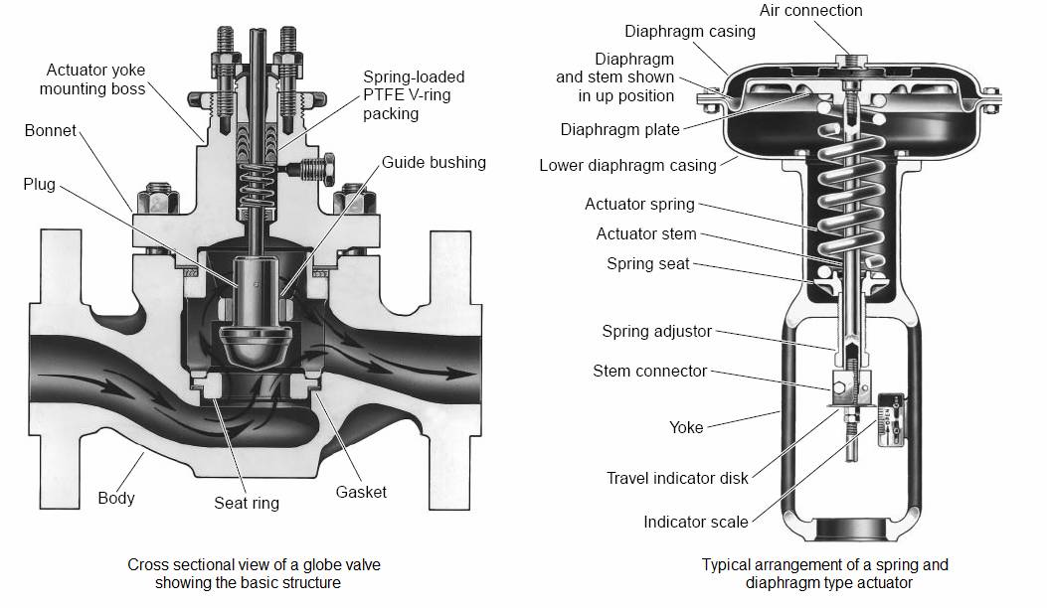
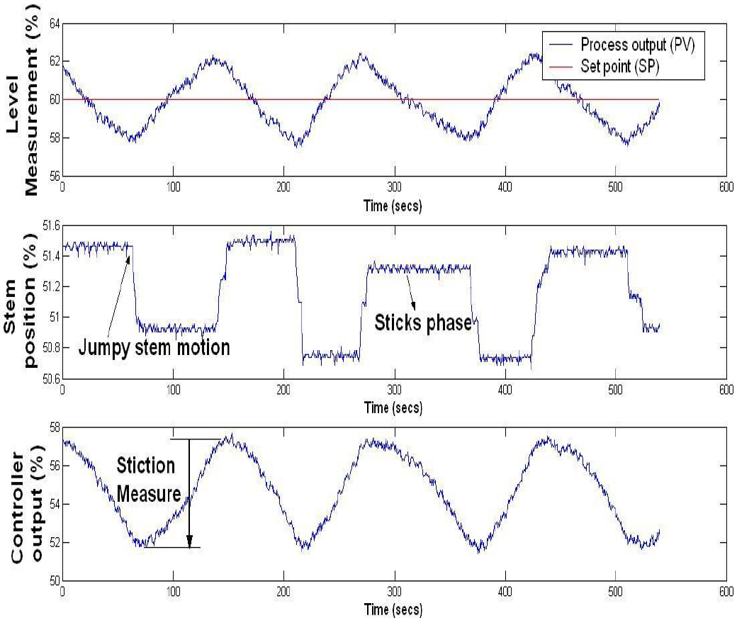
VALVE Stiction

Slide 8
Classical methods
Bicoherence for Non linearity detection
OP/PV biplot for stiction quantification

Slide 9
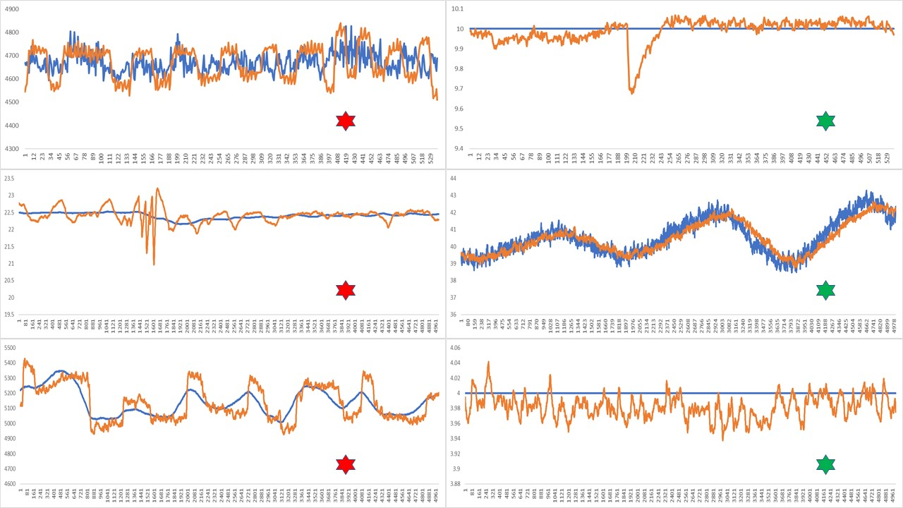
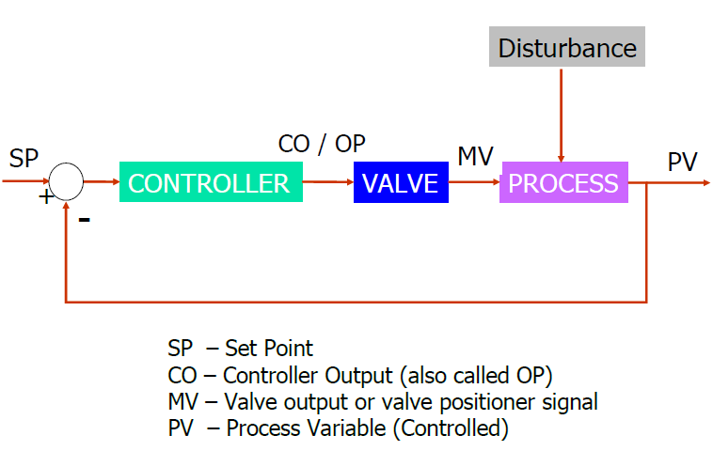
VALVe Stiction
Stiction Present
Stiction Not Present
Process Variable (PV)
Set Point
Stiction is resistance to the start of motion.
2% Stiction means that when valve gets stuck, it will start moving only after the cumulative change of its control signal is greater than or equal to 2%.
Notes:
How control engineers detect stiction visually?
Stiction is the resistance to the start of motion, usually measured as the difference between the driving values required to overcome static friction upscale and downscal

Slide 10
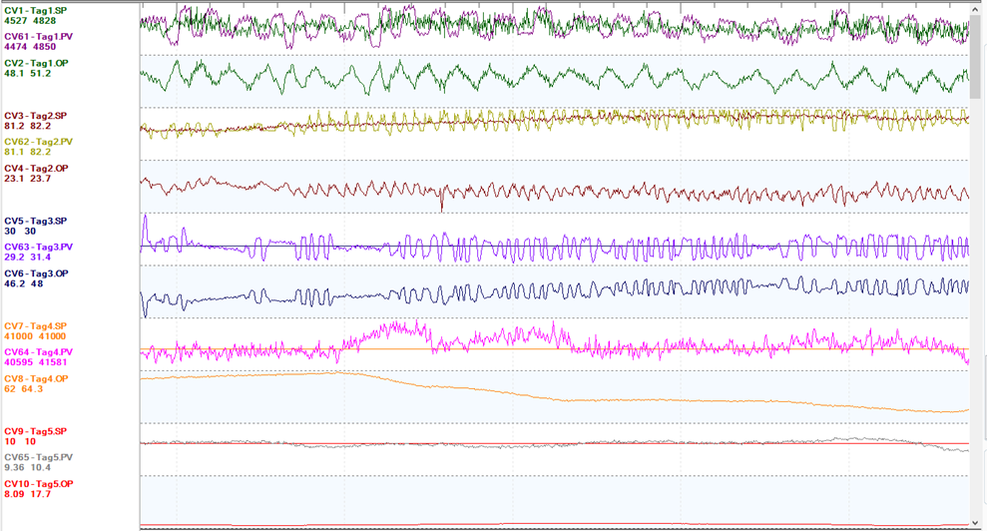
Sticky valves

Slide 11
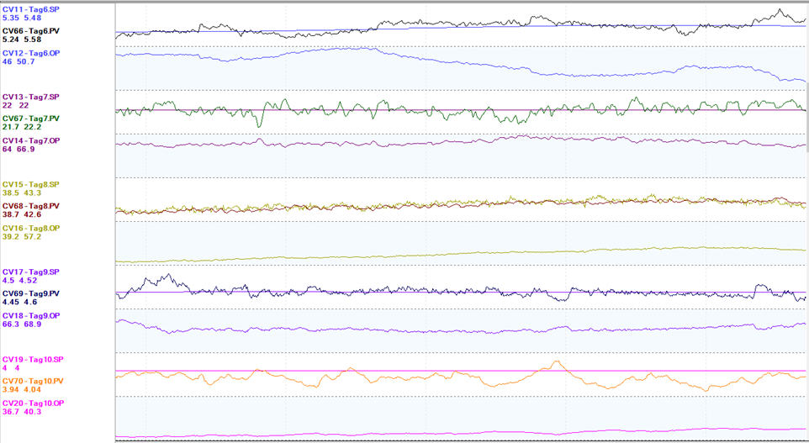
Non sticky

Slide 12
Different types of Neural networks
considered in this work

Slide 13
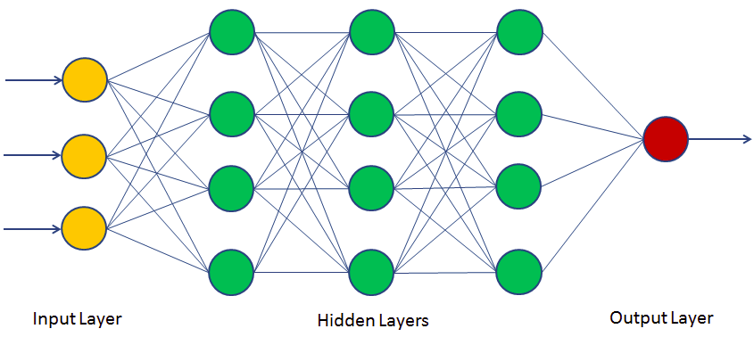
Multi layer perceptron NEURAL network
Typically used for:
Tabular datasets
Classification prediction problems
Regression prediction problems
Also known as Fully Connected Network
MLPs are universal function approximators
Notes:
universal approximation

Slide 14
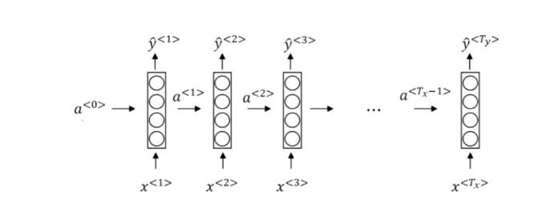
Recurrent neural network
Applications
Language Translation
Speech recognition (Alexa, Siri, Google)
Time series prediction
Time series anomaly detection
Text Generation
Sentiment classification
Handwriting recognition
Handwriting generation
Music generation
Image captioning
Natural Language processing
It’s the same model at each time step but new data is fed in as well as a summary of everything that gone before.
Sharing of weights for all samples in a sequence

Slide 15
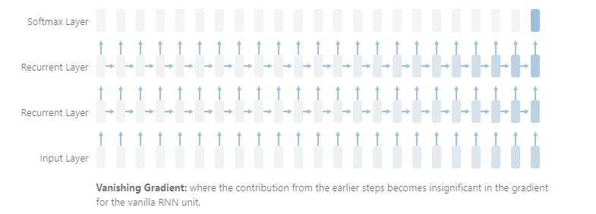

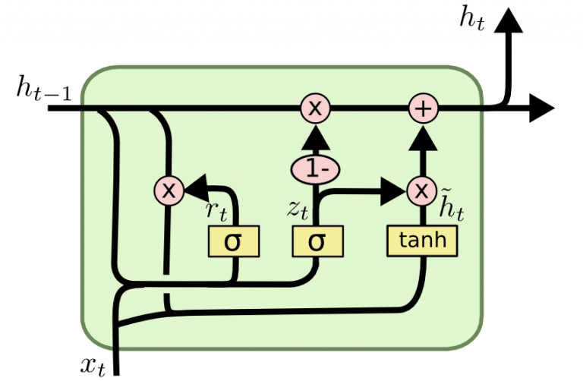
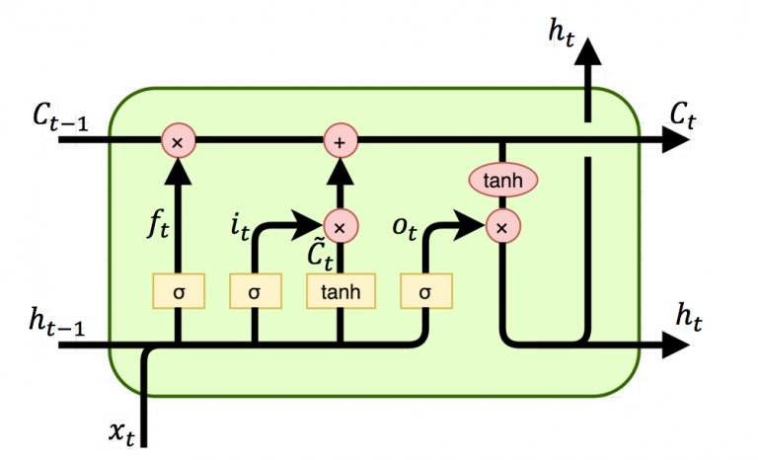
Recurrent neural network
Vanishing Gradients
the cat, which already ate ……., was full
Need to keep word Cat in memory to understand the complete sentence.
LSTM : Long short term memory
GRU : Gated Recurrent Unit
GRU/LSTM cells are trained to remember what they need to and forget what they don’t.
GRU
LSTM

Slide 16

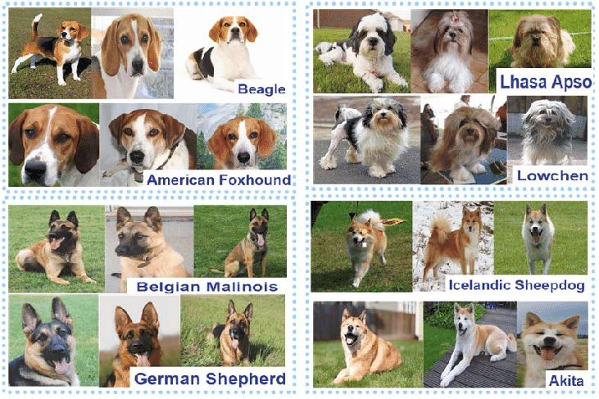

Convolution NEURAL NETWORK
Image Source: https://www.researchgate.net/publication/283813525_Dog_breed_classification_via_landmarks

Slide 17
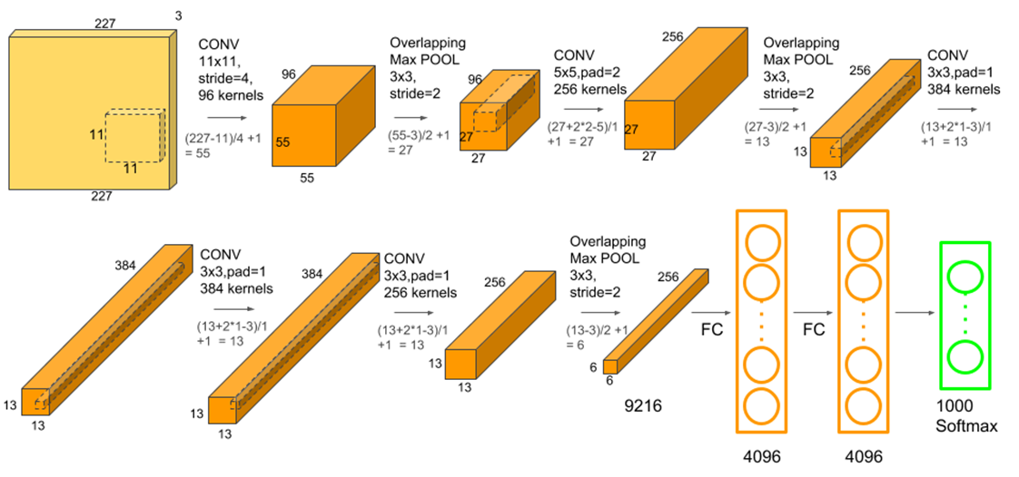
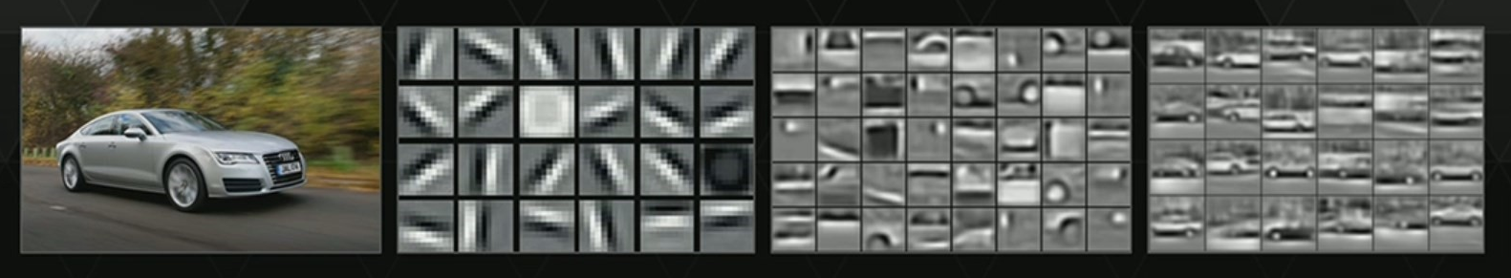
Convolution NEURAL NETWORK
2012 paper : AlexNet
Applications
Computer Vision
Image Recognition
Image classification
Natural language processing
Timeseries
Image recognition is now better than humans

Slide 18


Slide 19
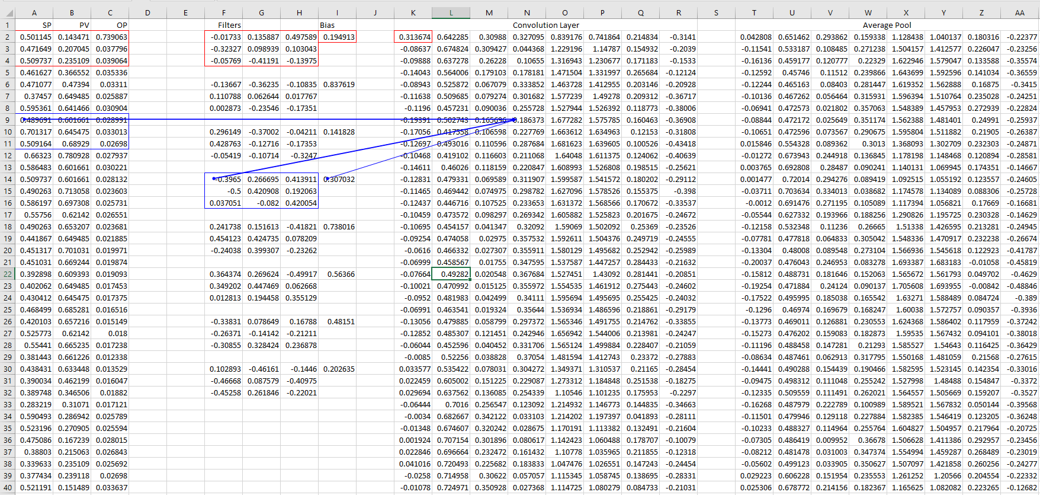
Convolution neural network (1D)
2998 X 8
999 X 8
3000 X 3
(3*3+1)*8
= 80

Slide 20
Stiction detection Project

Slide 21
Data description
 | Phase 1: Simulated Data | Phase 2 : Real Plant Data
Source | PID Loop Simulator | Plant Data
Flow Loops (PV, OP, SP) | 3,000 | 10,077
# of samples in each time series (@ 5 sec interval) | 2,000 | 5,000
Annotation Method | Threshold based | Manual
Data was scaled using Min Max Scaling

Slide 22
Initial attempts
First attempt was to use LSTM
Started with simulated data with CNN-1D. Got good results
Tried dropout for regularization
Instead of using time series in CNN-1D, created plots of 300 pixels height programmatically.
Didn’t see any benefits with plots , continued with time series.
Started with industrial data (10077 loops) not able to run on laptop / VM
Got access to HPC server with GPU
Tried with industrial data on HPC , accuracy ~80%
Increasing model size caused overfitting

Slide 23
Data Augmentation
Data augmentation : In pictures, typically data augmentation is done by
Rotating, Horizontal Flipping, Scaling, Cropping, Translation, Scaling, Adding Gaussian Noise.
In Stiction study as we have used time series we could not use most of these techniques.
Only possibilities (in my opinion)
1. Resampling :
a) e.g. Use every 2nd, 3rd, 5th sample etc.
b) Subsample using interpolation
2. Taking a window of data with different starting sample
3. Cropping . Provide segment of constant values in beginning , ending or in between.

Slide 24
Accuracy- Augmented data
Training Set
Actual Output | Predicted value | Count | Percentage
0 | 0 | 209934 | 97.07%
0 | 1 | 6347 | 2.93%
1 | 0 | 16481 | 25.41%
1 | 1 | 48386 | 74.59%
Total Sticky loops |  | 64867 | 23.07%
Total Non Sticky loops |  | 216281 | 76.93%
Test Set
Actual Output | Predicted value | Count | Percentage
0 | 0 | 23204 | 96.31%
0 | 1 | 889 | 3.69%
1 | 0 | 2172 | 30.39%
1 | 1 | 4974 | 69.61%
Total Sticky loops |  | 7146 | 22.88%
Total Non Sticky loops |  | 24093 | 77.12%
True Negative
False Positive
False Negative
True Positive
Good results for True Negative >95%, but non sticky better than sticky as data not balanced

Slide 25
Data balancing
Data Balancing : Number of loops with stiction were quarter of the loops without stiction.
More data augmentation done for sticky loops as compared to non sticky.

Slide 26
After Balancing data
Training Set
Actual Output | Predicted value | Count | Percentage
0 | 0 | 120861 | 92.61%
0 | 1 | 9644 | 7.39%
1 | 0 | 4268 | 3.77%
1 | 1 | 108858 | 96.23%
Total Sticky loops |  | 113126 | 46.43%
Total Non Sticky loops |  | 130505 | 53.57%
Test Set
Actual Output | Predicted value | Count | Percentage
0 | 0 | 28860 | 89.27%
0 | 1 | 3470 | 10.73%
1 | 0 | 1895 | 6.63%
1 | 1 | 26682 | 93.37%
Total Sticky loops |  | 28577 | 46.92%
Total Non Sticky loops |  | 32330 | 53.08%
True Negative
False Positive
False Negative
True Positive
Notes:
Unbalanced data – change the augmentation
With 80-20 split

Slide 27
Hyper parameter tuning/trials
Changed from max pooling to average pooling not much impact.
Number of Convolution layers and kernels, kernel size, strides
Regularization (Dropout)
Batch Normalization
Activation functions

Slide 28
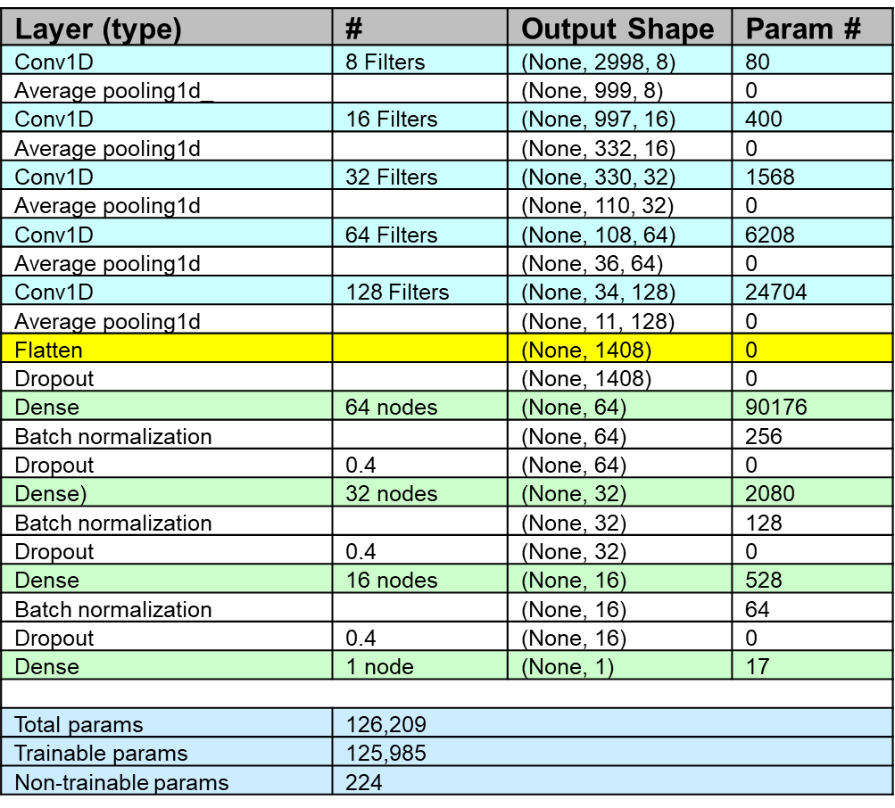
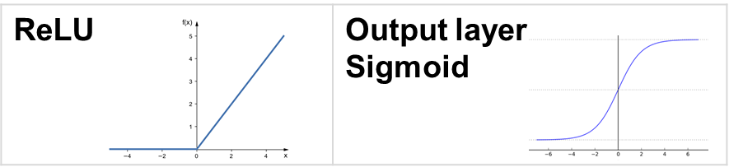
Model
Python
NumPy
Pandas
Matplotlib
Keras + TensorFlow
Scikit-learn

Slide 29
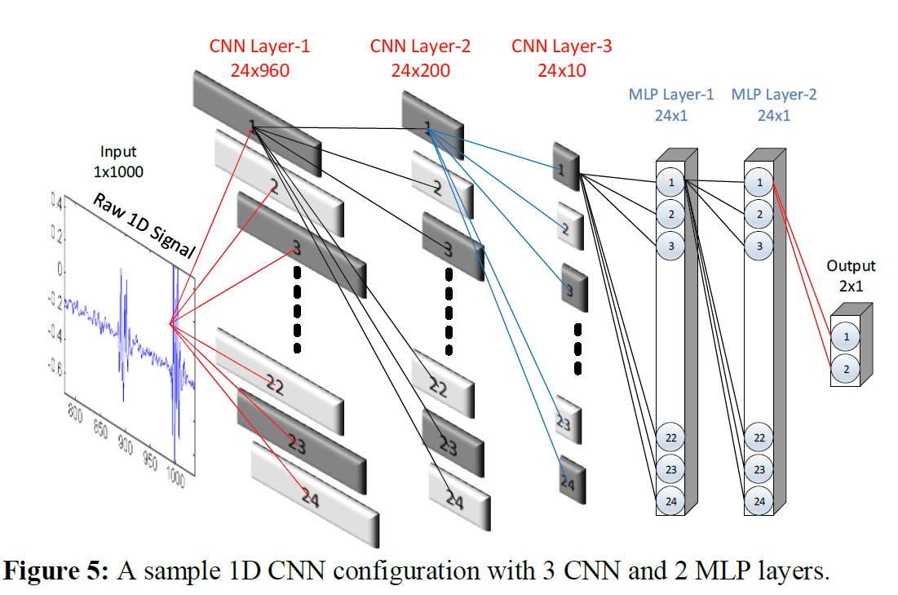
1D Convolutional Neural Networks
3D Input Tensor

Slide 30
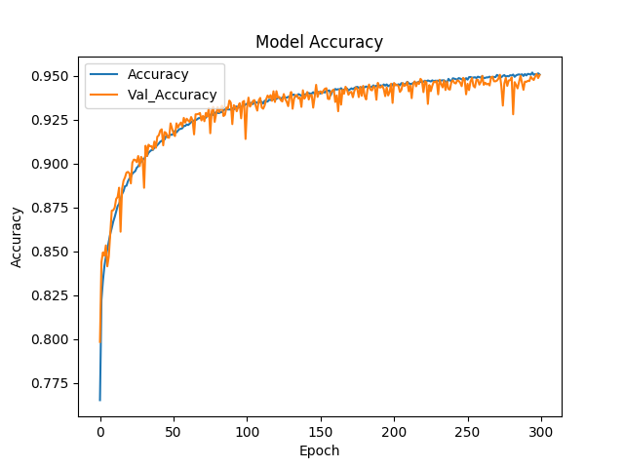
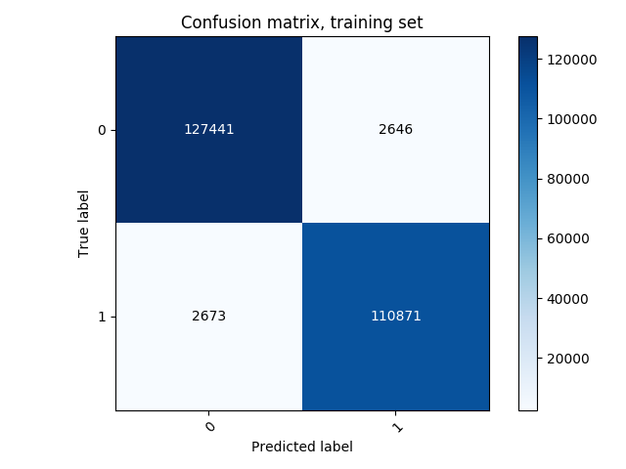
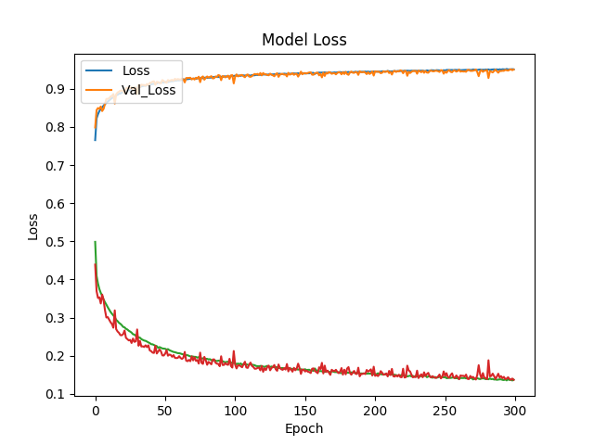
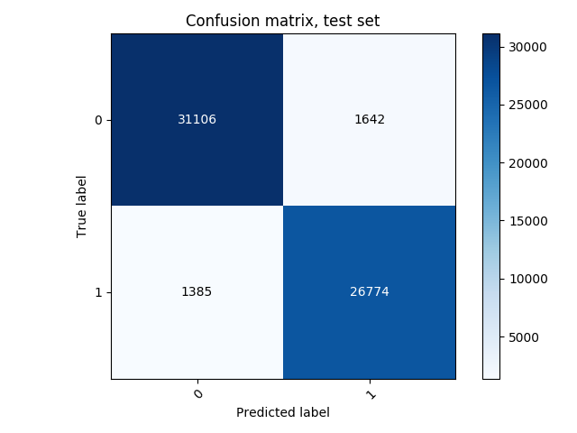
Results
98.0%
2.0%
2.4%
97.6%
95.0%
5.0%
4.9%
95.1%

Slide 31
Pros and cons
Positives
The final output layer will be able to perform multi-classifications, this same network can be applied to detect oscillation/variance and tuning issues in control loops
This method is unit agnostic, it only needs process value (PV), Setpoint (SP), and output (OP).
The input tensor comprising of the whole batch (all loops) or mini batch (based on memory needed) can be processed simultaneously in very less time.
we can use crowd sourcing by taking feedback of control engineers
No threshold specifications required
Not dependent on sampling time
Negatives :
The loops like Level / Temperature, (or problems) which are difficult to label by humans can not be added in training set.
KPIs which have some quantification: % stiction, Oscillation period.

